Slide 1
80286/80386 Microprocessor
Lecture 15

Slide 2
Features of 80286
24-bit address bus.
Able to address 16MB of physical memory.
1GB of virtual memory.
It has a MMU[memory management unit]
It operates in 2 modes
Real address mode
Protected virtual address mode

Slide 3
INTERNAL ARCHITECTURE OF 80286
Register organisation of 80286
A)Eight 16-bit general purpose registers
B)Four 16-bit segment registers
C)Status & control registers
D)Instruction pointer
All the above same as 8086

Slide 4
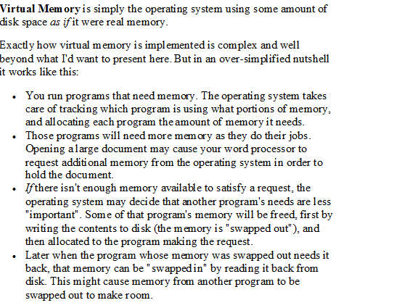

Slide 5
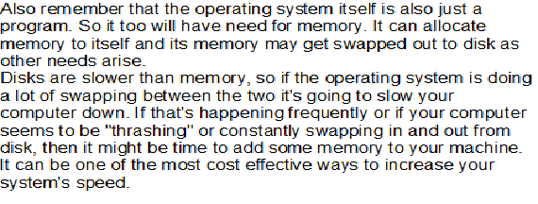

Slide 6
Additional fields available in 80286 flag register
IOPL[I/O Privilege field]-bits D12&D13
NT[Nested task flag]-bit D14
PE[Protection enable]-bit D16
MP[Moniter processor extension]-bit D17
EM[Processor extension emulator]-bit D18
TS[Task switch]-bit D19

Slide 7
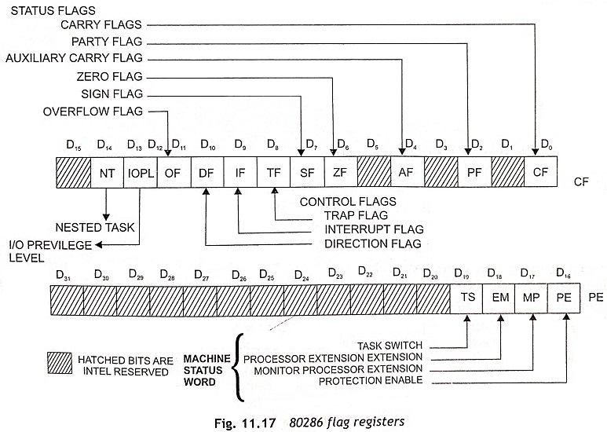

Slide 8

Flags Register
NT =1 indicates a Nested Task (current task was called by another task).
IOPL flag (I/O Privilege Level).
I/O requests having privilege level equal to or higher than IOPL flag will be executed.

Slide 9

MSW (Machine Status Word)
PM = Protected Mode
  1 = Protected Mode; 0 = Real mode
  at startup: PM=0
MP = Math Coprocessor
  1 = Present; 0 = Not Present
EM = Math Coprocessor is emulated by software
  1 = Emulated; 0 = Not Emulated
TS = Task Switch is taking place
  1 = Yes; 0 = No

Slide 10
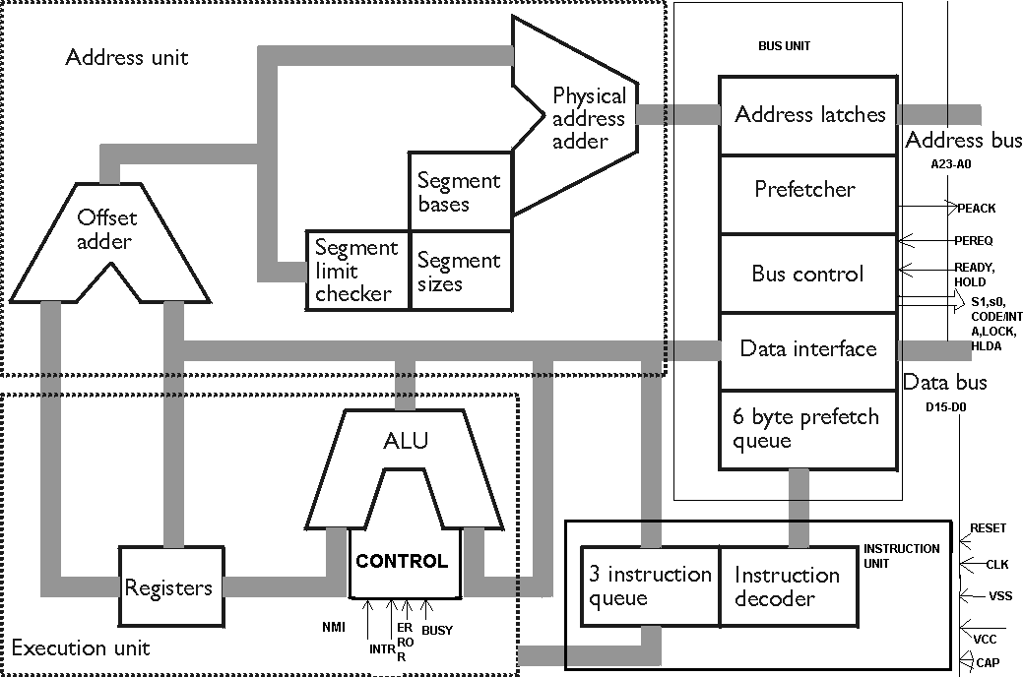
BLOCK DIAGRAM OF 80286

Slide 11
4 functional parts.
1)Address unit
2)Bus unit
3)Instruction unit
4)Execution unit

Slide 12
Functional parts
ADDRESS UNIT
The address unit calculates the physical address of instructions & data.The address computed by AU is handed over to BU.
BUS UNIT
It fetches instruction bytes from the memory.Instructions are fetched in advance[Instruction Pipelining].These fetched instructions are arranged in a 6-byte prefetch queue.

Slide 13
Functional parts
INSTRUCTION UNIT
The 6-byte prefetch queue forwards the instructions arranged init to the IU.It accepts instructions from prefetch queue & an instruction decoder decodes them one by one.Decoded instructions are latched onto a decoded instruction queue.
EXECUTION UNIT
The o/p of the decoding circuit is given to EU which is responsible for executing the instructions received from the decoded instruction queue.ALU carries all the arithmetic & logic operations.

Slide 14
2 modes
Real mode
In this mode 80286 act as a fast 8086
It addresses only 1MB of physical memory using A0-A19
20-bit physical address is formed like 8086
Contents of segment registers are used as segment base address
When the 80286 is reset ,it always starts its execution in real address mode
In real mode first 1kb of memory is reserved for interrupt vector table
Addresses FFFF0H to FFFFFH are reserved for system initialization.

Slide 15
PROTECTED VIRTUAL ADDRESS MODE(PVAM)
Virtual memory does not exist physically but it is available in the system
The procedure of fetching the chosen pgm. Segments or data from the secondary storage into the physical memory is called swapping
So it can address 1GB
Physical address calculation in PVAM
It uses 16-bit content of a segment register as a selector to address a descriptor stored in physical memory
The descriptor is a block of contiguous memory locations containing information of a segment
Privilege levels prevent unauthorized accesses
Maximum segment size will be of 64kb

Slide 16
Segment descriptor cache registers
Caching was introduced in 80286 to minimise the time required for fetching the frequently required descriptor from the main memory
Caching is the maintaining of the most frequently required data for execution in a high speed memory called cache memory

Slide 17
Local and global descriptor table
A descriptor table is an array of 8k descriptors
8byte entry in the table
8k*8=64kb of memory
GDT-global descriptor table contains global descriptors common to all the tasks
LDT-local descriptor table contains descriptors specific to a particular task

Slide 18
Chapter Overview
Internal Microprocessor Architecture
The Programming Model
Real Mode Memory Addressing
Segments and Offsets
Default Segment and Offset Registers
Protected Mode Memory Addressing

Slide 19
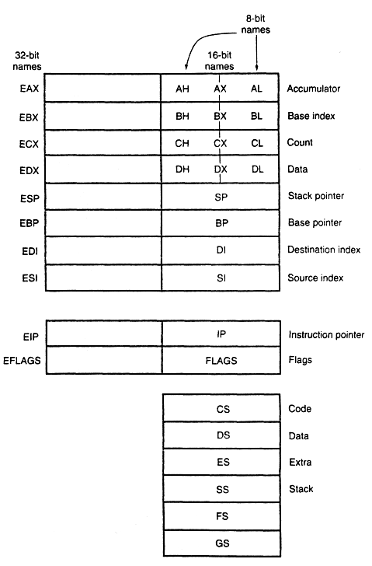
Internal Microprocessor Architecture

Slide 20
Multipurpose Registers
EAX | EAX (accumulator) a 32-bit register (EAX), a 16-bit register (AX), or of two 8-bit registers (AH and AL).
EBX | EBX (base index) sometimes holds the offset address of a location in the memory.
ECX | ECX (count) is a general-purpose register that also holds the count for various instructions.
EDX | EDX (data) holds a part of the result from a multiplication or part of the dividend in division.
EBX | EBP (base pointer) points to a memory location for memory data transfers.
EDI | EDI (destination index) often addresses string destination data for the string instructions.
ESI | ESI (source index) often addresses source string data for the string instructions.

Slide 21
Special-purpose Registers.
EIP | EIP (instruction pointer) addresses the next instruction in a section of memory defined as a code segment. This register is IP (16 bits) when the microprocessor operates in the real mode and EIP (32 bits) when the 80386 and above operate in the protected mode.
ESP | ESP (stack pointer) addresses an area of memory called the stack. The stack memory stores data through this pointer and is explained later in the text with instructions that address stack data.
EFLAGS | EFLAGS indicate the condition of the microprocessor and control its operation. Figure 2-2 shows the flag registers of all versions of the microprocessor.

Slide 22
Segment Registers
CS | The CS (code segment) is a section of memory that holds the code (programs and procedures) used by the microprocessor. The code segment register defines the starting address of the section of memory holding-code.
DS | The DS (data segment) is a section of memory that contains most data used by a program. Data are accessed in the data segment by an offset address or the contents of other registers that hold the offset address.
ES | The ES (extra segment) is an additional data segment that is used by some of the string instructions to hold destination data.
SS | The SS (stack segment) defines the area of memory used for the stack. The stack entry point is determined by the stack segment and stack pointer registers.
FS-GS | The FS and GS segments are supplemental segment registers to allow two additional memory segments for access by programs.

Slide 23
Real Mode Memory Addressing
The 80286 and above operate in either the real or protected mode.
Only the 8086 and 8088 op­erate exclusively in the real mode.
Real mode operation allows the microprocessor to address only the first 1M byte of memory space—even if it is the Pentium 4 microprocessor.
Note that the first 1M byte of memory is called either the real memory or conventional memory system.
The DOS operating system requires the microprocessor to operate in the real mode.
Real mode operation allows application software written for the 8086/8088, which contains only 1M byte of memory, to function in the 80286 and above without changing the software.

Slide 24
Segments and Offsets
A combination of a segment address and an offset address access a memory location in the real mode.
All real mode memory addresses must consist of a segment address plus an offset address.
The segment address, located within one of the segment registers, defines the beginning address of any 64K-byte memory segment.
The offset address selects any location within the 64K byte memory segment.
Segments in the real mode always have a length of 64K bytes.

Slide 25
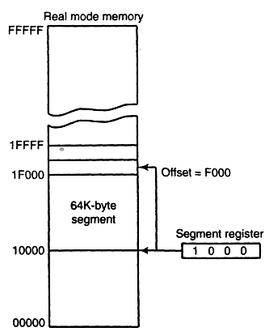
Example: The real mode memory-addressing, using a segment address plus an offset.
The segment register = 1000H,
The starting segment = 10000H.
In the real mode, each segment register is internally appended with a 0H on its rightmost end.
a memory segment that begins at location 10000H and ends at location 1FFFFH— 64K bytes in length.
It also shows how an offset address, sometimes called a displacement, and of F000H selects location 1F000H in the memory system.

Slide 26
8086-80486 and Pentium-Pentium 4 de­fault 16-bit segment and offset address combinations.
Segment | Offset | Special Purpose
CS | IP | Instruction address
SS | SP or BP | Stack address
DS | BX, DI, SI, an 8-bit number, or a 16-bit number | Data address
ES | DI for string instructions | String destination address

Slide 27
80386 through Pentium 4 default 32-bit segment and offset address combinations.
Segment | Offset | Special Purpose
CS | EIP | Instruction address
SS | ESP or EBP | Stack address
DS | EAX, EBX, ECX, EDX, ESI, EDI, an Data address 8-bit number, or a 32-bit number | Data address
ES | EDI for string instructions | String destination address
FS | No default | General address
GS | No default | General address

Slide 28
Protected Mode Memory Addressing
Protected mode memory addressing (80286 and above) allows access to data and programs located above the first 1M byte of memory.
Addressing this extended section of the memory system requires a change to the segment plus an offset addressing scheme used with real mode memory addressing.
When data and programs are addressed in extended memory, the offset address is still used to access information located within the memory segment.
One difference is that the segment address, as discussed with real mode memory addressing, is no longer present in the protected mode.

Slide 29
In place of the segment address, the segment register contains a selector that selects a descriptor from a descriptor table.
The descriptor describes the memory segment's location, length, and access rights.
The difference between modes is in the way that the segment register is interpreted by the microprocessor to access the memory segment.
Another difference, is that the offset address can be a 32-bit number instead of a 16-bit number in the real mode.

Slide 30
Selectors and Descriptors
The selector, located in the segment register, selects one of 8192 descriptors from one of two tables of descriptors.
The descriptor describes the location, length, and access rights of the segment of memory.
Indirectly, the segment register still selects a memory segment, but not directly as in the real mode.
In the protected mode, this segment number can address any memory location in the entire system for the code segment.
There are two descriptor tables used with the segment registers: one contains global de­scriptors and the other contains local descriptors.
.

Slide 31
The global descriptors contain segment definitions that apply to all programs,
The local descriptors are usually unique to an application.
You call a global descriptor a system descriptor and call a local descriptor an application descriptor.
Each descriptor table contains 8192 descriptors, so a total of 16,384 total descriptors are available to an application at any time.

Slide 32
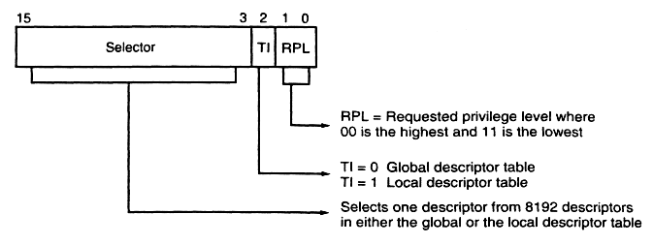
The contents of a segment register
Descriptors are chosen from the descriptor table by the segment register.
The segment register contains a 13-bit selector field, a table selector bit, and a requested privilege level field.
The 13-bit selector chooses one of the 8192’descriptors from the descriptor table.
The TI bit selects either the global descriptor table (TI = 0) or the local descriptor table (TI = 1).
The requested privilege level (RPL) requests the access privilege level of a memory segment. The highest privilege level is 00 and the lowest is 11. If the requested privilege level matches or is higher in priority than the privilege level set by the access rights byte, access is granted.

Slide 33
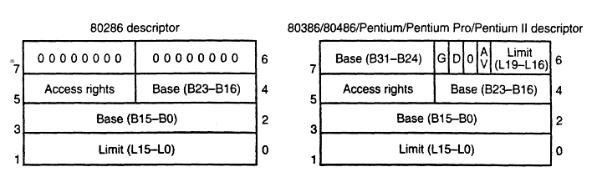
The descriptor formats for the 80286 and 80386 microprocessors.

Slide 34
The descriptor for the 80286 and 80386 microprocessors.
each descriptor is 8 bytes in length.
The base address indicates the starting location of the memory segment.
For the 80286 microprocessor, the base address is a 24-bit address, so segments begin at any location in its 16M bytes of memory.
The 80386 and above use a 32-bit base address that allows segments to begin at any location in its 4G bytes of memory.
The segment limit contains the last offset address found in a segment.
The access rights byte controls access to the protected mode memory segment. This byte describes how the segment functions in the system.

Slide 35
The descriptor for the 80286 and 80386 through Pentium 4 microprocessors.
G = granularity bit
The AV bit, indicate that the segment is available (AV = 1) or not available (AV = 0).
The D bit indicates how the 80386 through the Pentium 4 instructions access register and memory data in the protected or real mode.
If D = 0, the instructions are 16-bit instructions, compatible with the 8086-80286 microprocessors.
If D = 1, the instructions are 32-bit instructions.

Slide 36
The G bit, or Granularity bit
The G bit, or granularity bit If G = 0, the limit specifies a segment limit of 00000H to FFFFFH.
If G = 1, the value of the limit is multiplied by 4K bytes (appended with XXXH).
The limit is then 00000XXXH to FFFFFXXXH, if G = 1.
This allows a segment length of 4K to 4G bytes in steps of 4K bytes.

Slide 37
The G bit, or Granularity bit
Example:
Base = Start = 10000000H
G = 0
End = Base + Limit = 10000000H + 001FFH = 100001FFH
Example:
Base = Start = 10000000H
G = 1
End = Base + Limit = 10000000H + 001FFXXXH = 101FFFFFH

Slide 38
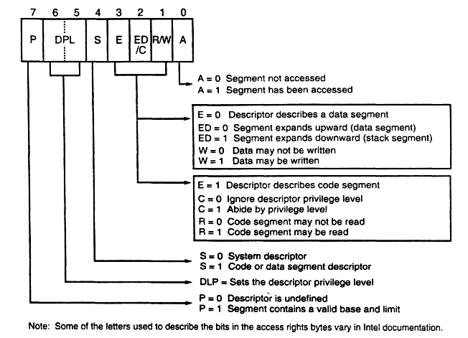
The access rights byte for the descriptor.

Slide 39
What are program-Invisible registers?
The global and local descriptor tables are found in the memory system.
In order to access and specify the address of these tables, the 80286, 80386, 80486, and Pentium through Pentium 4 contain program-invisible registers.
The program-invisible registers are not directly addressed by software so they are given this name.
The GDTR (global descriptor table register) and IDTR (interrupt descriptor table reg­ister) contain the base address of the descriptor table and its limit.
The TR (task register) holds a selector, which accesses a descriptor that defines a task. A task is most often a procedure or application program.

Slide 40
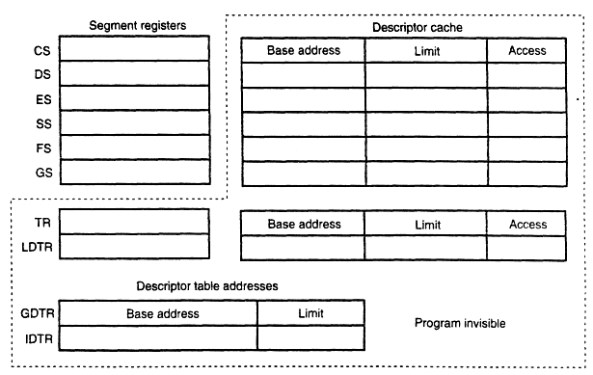
The program-invisible register within the 80286-Pentium 4 microprocessor.

Slide 41
MICROCONTROLLERS

Slide 42
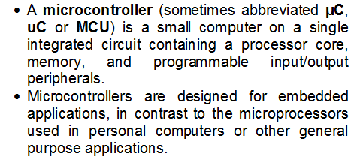

Slide 43
Embedded System
Special purpose computer system usually completely inside the device it controls
Has specific requirements and performs pre-defined tasks
Cost reduction compared to general purpose processor
Different design criteria
  Performance
  Reliability
  Availability
  Safety

Slide 44
Microcontrollers
Embedded Systems
  Operations managed behind the scenes by a microcontroller
Microcontroller (MCU)
  An integrated electronic computing device that includes three major components on a single chip
    Microprocessor (MPU)
    Memory
    I/O (Input/Output) ports
330_01

Slide 45
Microcontrollers
Support Devices
  Timers
  A/D converter
  Serial I/O
Common communication lines
  System Bus
330_01

Slide 47




Why Important?
Embedded Inside:
  Automotive systems
  Airplanes
  Toys
  Medical Devices
  Furniture
Billions of units

Slide 48
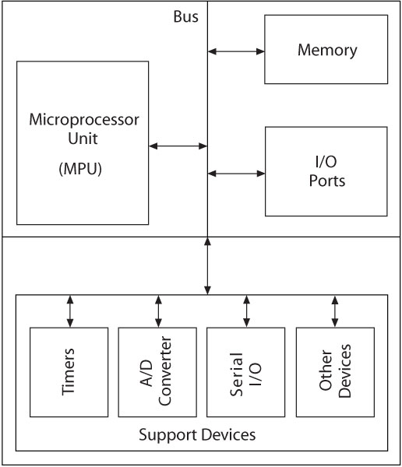
Block Diagram
330_01
Notes:
ELEC 330

Slide 49
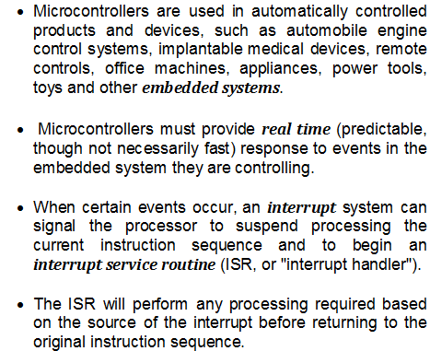

Slide 50
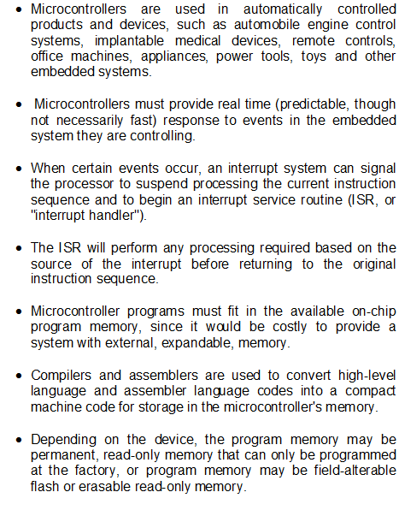

Slide 51
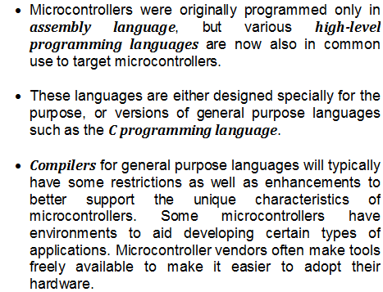

Slide 52
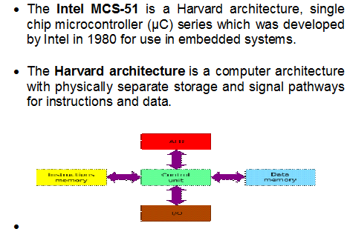

Slide 53
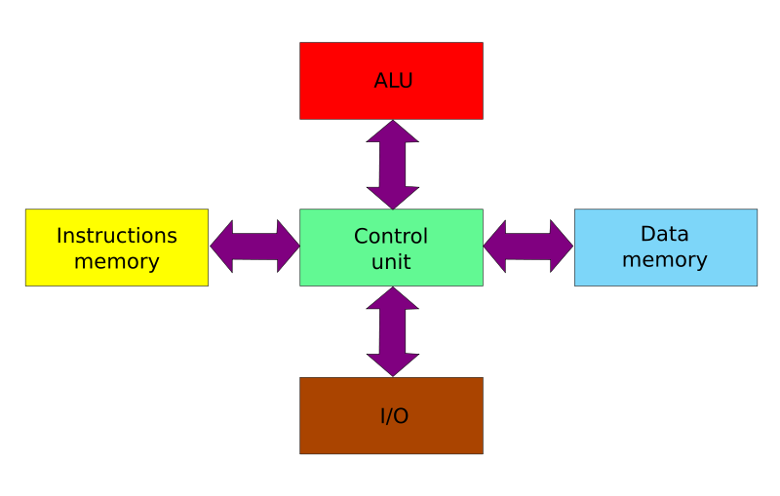

Slide 54
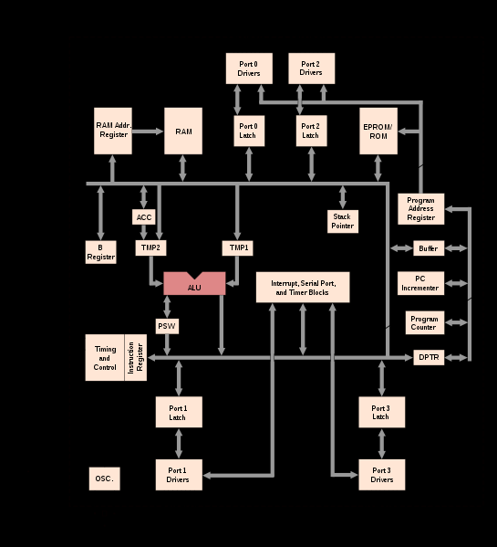

Slide 55
